Slide 1
Unit 4
Digital Impacts

Slide 2
Secure data storage & exchange processes
A digital solution that exchanges data over the Internet needs to consider three main security risks:
confidentiality (vs unauthorized access)
integrity (vs malicious corruption)
availability (vs interference)

Slide 3
Secure data storage & exchange processes
The main techniques developers use to help protect against these threats are:
encryption (via decryption key)
authorization (via signature, code or token)
checksums (checking for data corruption)
hashing (checking for malicious interference)

Slide 4
Encryption
Encryption transforms data in an unreadable format.
plaintext (unencrypted data)
ciphertext (encrypted data)
encryption or decryption process (algorithm)
key (used in the encryption and decryption process)

Slide 5
Symmetric Encryption
Well known symmetric block ciphers:
Triple DES
Encrypts data 3 times using a different key at least once – very slow. Good for PINs in ATMs
Blowfish
efficient open source algorithm for application encryption
splits message into 64 bit blocks and encrypts each block individually
Twofish is very similar but uses 128-bit blocks
AES
US Government Advanced Encryption Standard (128, 192 or 256 bit) replaced DES (64-bit) in year 2000

Slide 6
Asymmetric Encryption
A well-known asymmetric block cipher:
RSA
Public key to encrypt
Private key to decrypt
Widely used in internet and network security
Used in every website you visit with HTTPS:
HTTPS uses Secure Socket Layer (SSL) to encrypt data transfers between client and server
SSL uses the RSA algorithm

Slide 7
Authentication
Process of verifying someone is who they say they are. Methods include:
Username / password
One-step / two-step
Digital signatures
Digest Access Authentication - MD5(username:realm:password) .. Produces a hash
XML signature - <signature><method><hashvalue> … etc
Application tokens
OAuth2: authentication protocol that allows you to approve one application interacting with another on your behalf without giving away your password

Slide 8
Hashing
Successful hash characteristics:
Reliability
The same text should produce the same identical hash digest every time
One-way
Can’t reverse engineer text from hash digest
Collision resistance
No 2 hash digests should be alike
Speed
Salts (unique value that can be added to a word before hashing) can prevent pre-computed hash matching. Examples of hash algorithms include MD5 and SHA (SHA-1, SHA-256, SHA-512)

Slide 9
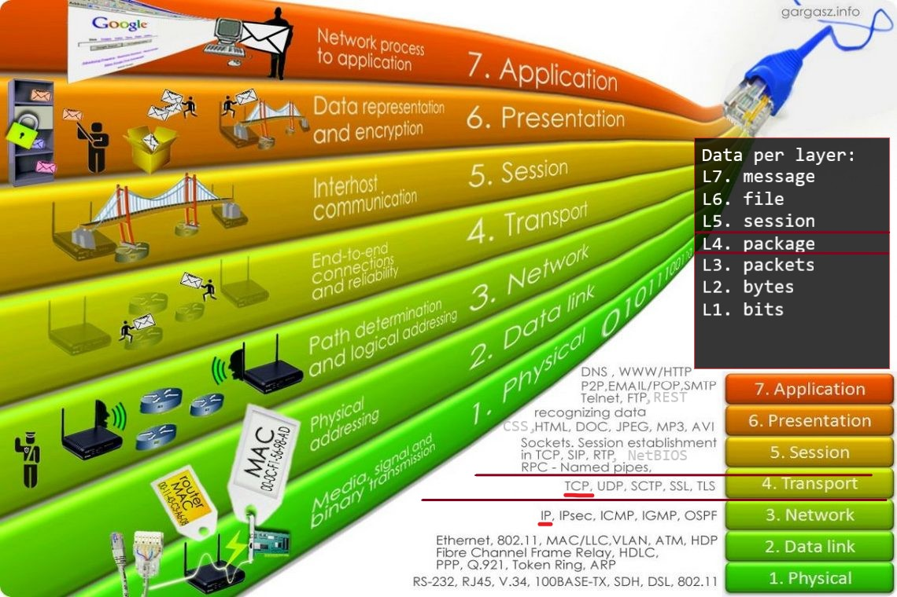
OSI Model

Slide 10
Latency
The delay between the time when an application requests data until it receives the data. Latency can be influenced by:
Serialization
The time taken to physically move data onto the network will be determined by the size of the packet and the speed of the network interface.
Propagation
The Internet is a heterogenous collection of high-speed and low-speed connections, some more reliable than others. The type of network media and the distance between the device requesting data / location of server or sensor (IoT) where data is stored will influence time
Switching
Packets inspected and processed by switches and routers takes more time
Queuing
During busy times, network devices may need to buffer packets before inspecting

Slide 11
Jitter, QoS guarantee and timeliness
Jitter
Packet delay variance (irregular latency in data exchanges)
Really affects user experience in synchronous data exchanges – VoIP conferencing, online gaming
Quality of Service guarantees
Best-effort service – no guarantees
Differentiated service – some traffic is treated better than other traffic
Guaranteed service – some network bandwidth is reserved for use only by mission-critical applications
Timeliness of delivery
Timeliness is the currency of a data packet at the time it is received

Slide 12
Internet protocols
HTTP
Hypertext Transfer Protocol
Methods GET, HEAD, POST, PUT, DELETE, TRACE, CONNECT, PATCH, OPTIONS
HTTPS
S = secure
Uses TLS / SSL encryption
FTP, VPN

Slide 13
Methods for exchanging data
RESTful services
API URI delivering JSON or XML
AJAX
Asynchronous JavaScript and XML
JSON
XML

